Slide 1
Angiographic catheters and hardwares
Dr . Praveen R V

Slide 3
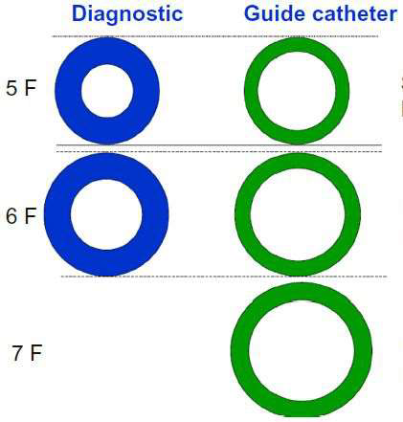
CORONARY CATHETERS
Diagnostic
GUIDE
Thicker shaft
Internal DM
Smaller
Tapering tip
Less Reinforced construction ( 2 layers)
Thinner shaft
Internal DM larger
Non tapering tip
More Reinforced construction ( 3 layers)

Slide 4
CHARACTERISTICS OF AN IDEAL CATHETER
Better torque control
increase the outer diameter
reinforced construction
Pushability
increase the outer diameter
stiffer material
decreases overall part length

Slide 5
Flexibility
increase the outer diameter
increases overall part length
material with less modulus of elasticity
Trackability
ease with which catheter follows a guide wire in a blood vessel

Slide 6
Radio-opacity
bismuth subcarbonate/oxychloride
barium sulfate
tungsten
Atraumatic tip
Kink resistance
ability to maintain the cross sectional shape
measured by placing a catheter segment between two plates and compressing it until it kinks

Slide 7
Parts of the catheter
A) TIP LENGTH – Increased length offers more
stability in target vessel
B) PRIMARY CURVE – angle of the target vessel
from its parent artery.
C) SECONDARY CURVE -- width of the parent
vessel.
D) TERTIARY CURVE –normal curvature of the
parent vessel.
E) CATHETER LENGTH – Usually 100 or 110 cm

Slide 9
Catheter materials
Angiographic catheters are made from synthetic and semisynthetic polymer
Dacron
Nylon
Polyvinyl chloride(PVC)
Polyethylene
Teflon(PTFE)
Polyurethane
silicone

Slide 10
Cross section of catheter
Strength
Support/Flexibility
Kink resistance
Polyurethane or Polyethylene
Internal lumen
Smooth or lubricious material
Device compatibility
PTFE (Polytetrafluoroethylene) like Teflon
1:1 Torque
Kink resistance
Stainless steel/ Kevlar

Slide 11
Characteristic of catheter material

Slide 12
polyurethane
Excellent memory
Softer than Teflon or polyethylene-less vascular trauma
Increased thrombogenisity
Reshaped if immersed in boiling water
Eg -Pigtail angiographic catheters and original judkins catheter

Slide 13
polyethylene
Stiffness in between polyurethane and Teflon
More thrombogenic than polyurethane and PVC
Heat mouldability good
Eg -Pigtail angiographic catheters and original judkins catheter

Slide 14
Polyvinyl chloride
Softest and flexible among all
High friction coefficient – spasm
Increased thrombogenisity
decreased tensile strenghth(memory)
Cant be reformed
Most hydrophilic
Drugs absorbed-NTG,insulin,diazepam,thiopentone
Eg- balloon tip flow directed balloon catheters

Slide 15
Teflon
Stiffest
Poor memory
Low friction coefficient
Eg- brockenbrough catheters,transducer tip catheter and introducer sheaths

Slide 16
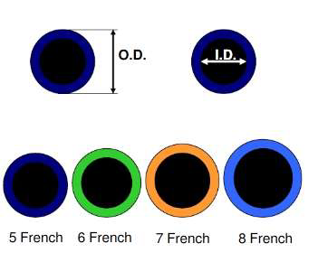
SIZE MEASUREMENT
FRENCH CATHETER SCALE:
outer diameter of cylindrical medical instruments.
D(mm) = Fr/3
Most commonly in adults -- Diagnostic Catheters of 5 – 7 Fr size.
Colour coding

Slide 17
Commonly used catheters

Slide 18
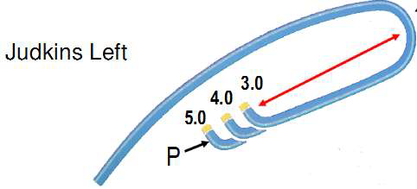
JUDKINS
Curve length = distance between P
(primary curve) & S (secondary curve)
Notes:
Melvin Judkins in 1967, Tapered tip with end hole, Designed for femoral route , Length 100 cm, Size 3.5to 6 by most
Companies, 4-7 French available.

Slide 19
Judkin
Preformed catheter
Primary and secondary curve
Tappered tip with end hole
Designed for femoral route
Little manipulation is needed if used from femoral route

Slide 20
Judkins- dimensions
Lenghth – 100 cm
Size-3.5 – 6 by most companies
4-7F available(4F is most commonly used)
Right radial assess
0.5 size less for LCA
1 size larger for RCA
In aortic aneurysm heat modification of size 7F to 10F done

Slide 21
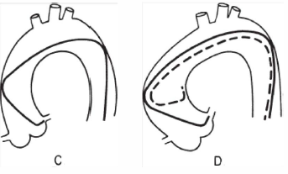
Cannulation of the Left Coronary Ostium
Notes:
IF NARROW OR SHORT - The left ostium may still be engaged despite this somewhat unfavorable situation by pushing the catheter down into the left sinus of Valsalva for approximately lO seconds to tighten the tip angle and then withdrawing the catheter slowly. Having the patient take a deep breath during this maneuver also helps by pulling the heart into a more vertical position to assist in engagement of the left ostium. The most satisfactory approach, however, is to exchange for a JL3 . 5 catheter with a shorter curve.

Slide 22
Cannulation of the Right Coronary Ostium
Notes:
To catheterize the rt coronary ostium , the R JL is advanced around the aortic arch with its tip directed leftward , as viewed in the LAO projection , until it reaches a position 2 to 3 cm above the level of the le ft corona ry ostium (E). Clockwise rotation causes the catheter tip to drop into the aortic root and point anteriorly ( F ) . Slight further rotation causes the catheter tip to enter the right coronary ostium (G).

Slide 23
Damping and Ventricularization of the Pressure Waveform
A fall in overall catheter tip pressure (damping) or a fall in diastolic pressure only (ventricularization)
Indicates obstruction of the catheter tip or interference with coronary inflow
Notes:
indicate ostial stenosis with absent reflux into the aortic root or retention of the injected contrast in the proximal- and midportion of the vessel

Slide 24
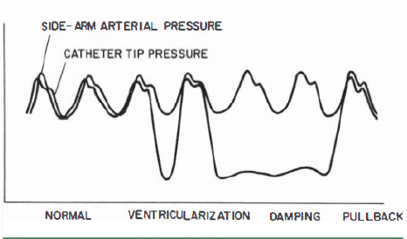
Small vessel
Ostial Spasm
Selective Engagement Of The Conus Branch
Ostial Stenosis

Slide 25
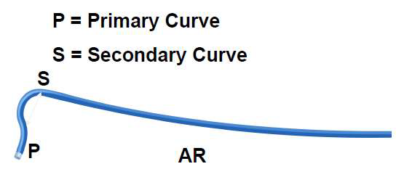
AMPLATZ
Notes:
Kurt Amplatz , Austrian Radiologist,1967 , usual sizes 1 ,2,3 with increasing curvature, AL - Coronory ostia out of conventional judkins Like high and posterior origin.. It can selectively canulate LAD or LCX if short left main stem. IT IS MORE TOLERENT OF ROTATIONAL MANEUERING
Separate origins of left anterior descending and left circumflex coronary arteries.
High anterior right coronary arteries (RCAs) or Shepherd’s Crook RCA.

Slide 26
Amplatz
Pre shaped half circle catheter
By kurtz amplatz,Austrian radiologist in 1967
Right and left comes in 3 sizes usually- 1,2,3 with increasing cuvature (diameter of tip curve)
Increment of 0.5 size is available for AL
Whle engaging the LCA , pushing the catheter causes disengagement and pulling the catheter causes deep engagement of AL due to it’s specific curve

Slide 27
Amplatz left - use
Coronary ostia out of conventional Judkin type – eg- high and posterior origin
Can selectively canulate LAD and LCX if LMCA is short
Separate origin of LAD and LCX
High anterior RCA or shepherd crook’s RCA
Amplatz right -uses
Abnormal RCA origin –high anterior or inferior origin

Slide 28
MULTIPURPOSE CATHETER
Polyurethane catheter
Single curve with straight tip an end hole and two side holes.
Use: CAG – Both native vessel and graft ,Ventriculography , Right heart catheterization.
MP A-1 : 1 end hole only
MP A-2 : 2side holes ,1end hole
MP B-1 : 1 end hole only
MP B-2: 2 sideholes and an end hole
Notes:
By Schoonmaker & King , In 1974

Slide 31
Radial access –advantages and disadvantages

Slide 34
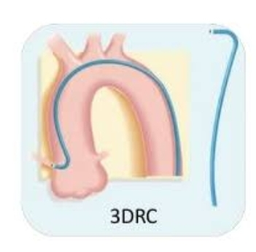
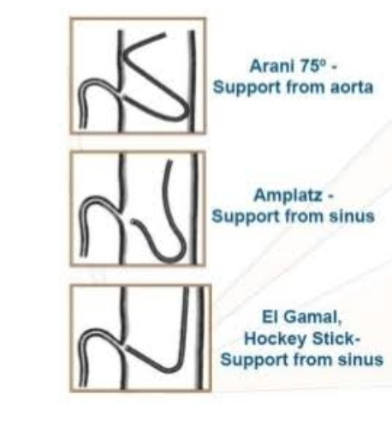
Other catheters
3DRC- three right curve –for tortous,bent anatomy and superior or posterior take off of RCA
Arani –
Double angle 90 degree curve sits on ascending aorta in s configuration and is therefore useful for RCA with horizontal take off and shephered crook RCA
Primary and secondary curves provide two contact points on the opposite side of aorta thus providing tremendous back up support

Slide 35
XBR and XBRCA – new catheters developed specifically for the inferior and superior take off of RCA respectively
El-Gamal – pre shaped catheter with improved distal end portion for accessing bypass grafts and more precise access of RCA

Slide 36
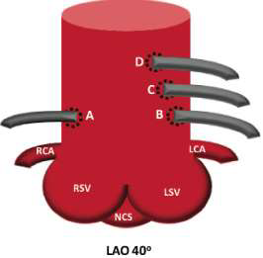
Saphenous Vein and Arterial Grafts
A-dRCA / dLCX (in L dominant system)
B- LAD
C- Diagonal
D- LCX/OM/RI
Right coronary grafts from right anterior surface and left coronary grafts from left anterior surface
Ring markers

Slide 37
Catheter selection for grafts
Right Grafts
– Primary choice - MP
– Alternative – JR , RCB , AL
Left Grafts :
– Primary Choice – JR4 , AL1
– Upward trajectory may require - special LCB , IMA
– More anterior origin – AL ,LCB,MP

Slide 38
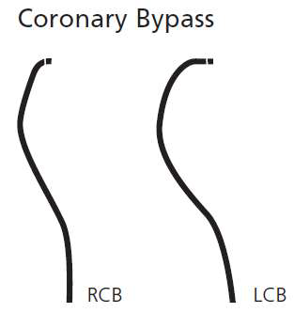
Bypass catheters
RCB
Resembles JR4 with a tip curved >90 degree
LCB
Primary curve similar to JR4 (90 degreee)
more secondary curve(70 degree)

Slide 39
LIMA and RIMA

Slide 40
Internal mammary catheter
Same as JR4 except for
tighter primary curve (80degree) and
longer tip

Slide 41
IMA canulation

Slide 43
Factors influenzing catheter selection
Height
Weight
Anatomy of aorta
Age
Access
Native vessel /grafts
Target vessels
ACS vs Elective
operator

Slide 46
Anatomy of aorta

Slide 47
Guide wires

Slide 48
Functions of guide wire
Wide range of guidewires with similar properties
Functions
access lesion
cross lesion
change vessel anatomy
device support

Slide 49
PROPERTIES OF AN IDEAL GUIDEWIRE
Push transmission or steerability
Ability of a guidewire tip to be delivered to the desired position in a vessel.
Torque transmission
Ability to transmit rotational forces from operators hand to the tip of guidewire.
Increased core thickness increases torquability.

Slide 50
Trackability:
Ability to advance interventional devices on the guidewire.
Flexibility:
Ability to bend with direct pressure.
Minimize vascular trauma.
Tip elasticity:
Shape memory retention of the distal tip throughout the entire procedure.

Slide 51
Tip visibility and markers:
Allows for visualization of distal tip in the vessel lumen.
Help in estimation of lesion length and choosing length of balloon catheters and stents.
Durability of the wire: kink resistance(wire can be used for multiple lesions)
Tactile feedback: feel of the wire tip

Slide 52
Prolapse tendency:
Tendency of the guidewire tip to kink once passed into a vessel.
Common with floppy tip guidewires
Problem when lesions are very tight or lesions are in angulated vessels.
After crossing the lesion, beneficial –reduces the possibility of guide wire trauma to distal vessel

Slide 53
COMPONENTS OF GUIDEWIRE
Central core composed of stainless steel or nitinol.
Distal tip – made of stainless steel /platinum/tungsten
Coating -Silicone, Polytetrafluroethylene (PTFE) or hydrophilic substances

Slide 54
Cross section of a guidewire

Slide 55
Longer taper- facilitates tracking,less support
Shorter taper –greater support at expense of prolapse

Slide 56
Core material
Stainless steel
Strong
Flexible
Better torqueability
Greater tactile feedback
Nitinol
Elastic
No shape retention when bend
Less torqueability
Less tactile feedback

Slide 57
Tip style

Slide 58
Spring coils

Slide 59
coils

Slide 60
covers

Slide 61
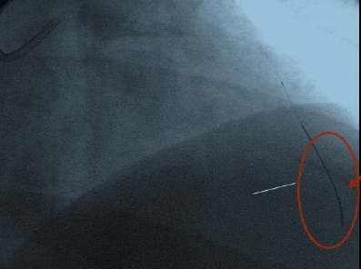
Radiopaque tip
Platinum coils placed at wire tip( distal 2 – 3 cm) provide visibilty(radio opaque).

Slide 62
coatings
Outer covering on the core that keeps the overall diameter consistent and improves the wire performance
Purpose of the coatings
To reduce the friction by facilitating the movement of the wire within the coronary anatomy and across the lesion, helping the wire negotiating tortuous anatomy
To improve deliverability by facilitating the movement of interventional equipment over the wires
The type and length of coatings may vary. most often coating is applied to the distal 30 cm of the wire

Slide 63
coatings
Hydrophilic
Hydrophobic
Attracts water
Applied over polymer and core of the wire including tip
Thin, non slippery dry solid-become gel when wet
Reduces friction and increases trackability
Repels water
Silicone on working area excluding tip
No accentuation/ wetting recquired
Increased friction – feeling of stability

Slide 64
Hydrophilic wires
PROS
Offer good manoevrability in tortuous vessels
CONS
More likely to penetrate beneath plaque and dissect
Tend to select small branches or vasovasorum and perforate more frequently

Slide 65
Non coated/ hydrophobic wires
PROS
More controllable,less likely to dissect
CONS
Poor trackability
Wire tip become stiffer,torque response increases.but less tip resistance is transmitted to the operator,making it easier to enter the false channel

Slide 66
Tip load
Floppy < 0.5 g
Balanced-0.5-0.9 g
Extra support->0.9 g

Slide 67
Lower support (tip load) decreases friction/ vessel wall injury and increases the wire durability
May adversely affect device deliverability/trackability

Slide 68
Classification of guidewires

Slide 69
Based on tip flexibility…….
Floppy – eg-Hi torque balance middle weight, Hi torque balance,choice floppy
Intermediate –eg- Hi torque intermediate,choice intermediate
Standard –eg- shinobi, boston scientific

Slide 70
Based on device support….
Light – eg- Hi torque balance
Moderate – eg- hi torque balance middle weight
Extra support- eg- hi torque whisper, choice
Support- indicator of core strength
More stronger the core- more support

Slide 72
Based on tip load……
Depending on the tip load the guidewires can be classified as balanced, stiff or floppy.
Tip load is defined as the force needed to bend a wire when exerted on a straight guide wire tip, at 1 cm from the tip.
As tip load increases, the wire becomes stiffer
provides more support
more prone to perforation.

Slide 73
Balanced guidewires
Tip load range between 0.5 and 0.9 g.
Balance between flexibility, support and stearability.
Constitute the bulk of use in any cath. lab -also called frontline guidewires or workhorse guidewires

Slide 74
stiff guidewires
Stiff guidewires are designed for cases where additional support is needed for device delivery.
Include intravascular tortuosity, calcification, noncompliance, previously deployed stents or when bulky devices are used.
The tip load is more than 0.9g.

Slide 75
Floppy wires
Tip load is <0.5 g
Soft guidewires are useful in negotiating a tortuous anatomy
May lack body support for device tracking
Once lesion is crossed, soft guidewire may be exchanged with a stiff guidewire.
stiff guidewires provide enhanced tracking of balloons and stents.

Slide 76
Based on coating….
Hydrophilic- eg – choice tm PT floppy
Hydrophophic – eg – asahi soft

Slide 77
Based on clinical scenario……
Wokhorse---for every day cases
Frontline Finesse….for tortuous anatomy
Extra support…device delivery
Speciality….for CTO

Slide 80
Diameter: 0.36mm(0.014 inch)
Spring coil length:11cm
Guide wire length:180/300cm
Tip: Straight/J

Slide 81
Diameter:0.23mm(0.009 inch)/0.36mm(0.014 inch)
Spring coil length:11cm
Guide wire length:190/300cm
Tip: Straight

Slide 82
Diameter: 0.36mm(0.014 inch)
Spring coil length:4cm
Guide wire length:180/300cm
Tip: Straight/J

Slide 83
WHISPER Guide Wire
Tip load:0.8/1/1.2 gm
Diameter: 0.36mm(0.014 inch)
Radiopaque length : 3cm
Guide wire length:190/300cm
Tip: Straight

Slide 84
Asahi SION blue
Tip load: 0.5g
Diameter: 0.36mm(0.014 inch)
Spring coil length:20cm
Guide wire length:180/300cm
Tip: Straight/J

Slide 85
Runthrough NS
Dual Core –
Main shaft core of SS & Distal core – Nitinol.
Tip-nitinol shaping ribbon

Slide 86
Tip load:3/4.5/6/12gm
Diameter: 0.36mm(0.014 inch)
Spring coil length:11cm
Guide wire length:180cm
Tip: Straight

Slide 87
Diameter: 0.23(0.009)/0.36mm(0.014 inch)
Spring coil length:20cm
Guide wire length:180cm
Tip: Straight

Slide 88
CROSS IT SERIES (100/200/300/400 XT)
Tip load:1.7/4.7/6.2/8.7gm
Diameter: 0.36mm(0.014 inch)
Radiopaque length : 3cm
Guide wire length:190/300cm
Tip: Straight/J

Slide 89
CTO wires
Features recquired for CTO wires
Penetration force – for penetrating proximal fibrous cap and advancing into true lumen
Pushability – for crossing chronic lesion and complex lesion with heavy calcification and tough fibrous tissues
Steerability – for easy manipulation in various direction with good torque control
Shaping memory of the tip

Slide 92
Commonly used CTO wires

Slide 100
Guide wires for retrograde techniques
Fielder/fielder FC
X-treme
Whisper
Choice PT2
Runthrough/runthrough hypercoat

Slide 101
Balloon catheters

Slide 102
Composition of a balloon
The first angioplasty balloon made by Gruentzig in 1976 was of polyvinyl chloride
The next generation balloon used cross linked polyethylene(PE)
PE ballons are as compliant as PVC , with higher rated burst pressure

Slide 103
Polyurethane makes makes balloon more resistant to damage
It produces the most durable balloon for a given thickness
Material used now are polyethylene terephthalate(PET) or nylon
PET offers good tensile strength

Slide 104
Nylon is not as strong as PET nor as compliant as PE
Nylon is softer, more easily refolded-easier to withdraw into the guiding catheter or introducer sheath

Slide 105
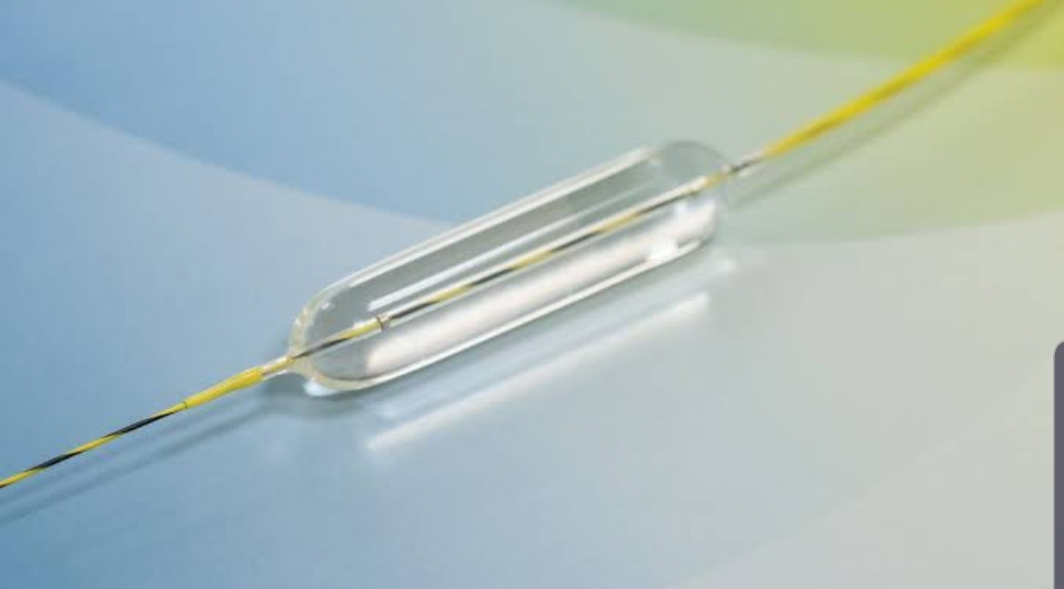
Parts of balloon
A standard dilation balloon consist of
Cylindrical body
Two conical tapers
Two necks(proximal and distal)

Slide 106
Balloon catheters used in angioplasty
Over the wire(OTW)
Rapid exchange design
Fixed wire balloon systems

Slide 107
Over the wire (OTW) balloon catheters
Balloon catheters which have two lumen running through the entire course of balloon catheters
One lumen is for passage of guide wire and other lumen is for connecting with an indeflator for balloon inflation and deflation
Useful when enhanced trackability is recquired and also in procedures recquiring multiple guidewire exchanges

Slide 108
Two operators recquired
Increased fluro time

Slide 109
Monorail or rapid exchange (Rx) balloon catheters
It is the current standard for PCIs
Two lumen
Guide wire lumen does not extend along the entire course o the balloon. It starts from distal end but finishes before the proximal end of the ballon catheter

Slide 110
Advantages of Rx balloon catheters
Allows a rapid exchange of interventional devices over the same standard length of guide wire
Significant reduction in procedural and fluoroscopy time
Allows the use of smaller diameter wires,catheters and stents
Technical success-similar to OTW balloon
It adds to safety of PCIs-lower dose of contrast medium, shorter FT and smaller device diameter

Slide 111
Fixed wire balloon system
Composed of an inelastic balloon wrapped around a smaller section of a guide wire
During introduction across a stenosis, the guidewire attached to the balloon can be rotated freely,but it cannot independently of the balloon
The wrapped configuration is maintained by means of temporary bond
Inflation of the balloon ,following proper positioning of catheter breaks the bond, permitting the balloon to unwrap from guidewire

Slide 112
Balloon coating
Variety of coatings can be added to the surface of a balloon to enhance or change it’s properties
Balloon may be coated for
Lubrication
Trackability
Abrasion resistance
Deliver an antistenotic drug

Slide 113
Terms used in context of angioplasty balloons
Balloon diameter – nominal inflated balloon diameter measured at a specified pressure
Balloon length- working length or length of straight body section
Nominal pressure-pressure at which when balloon is inflated ,it achieves the listed balloon diameter
Mean burst pressure (MBP)- average pressure at which 50% of balloons will burst(measured at body temparature)
Rated burst pressure(RBP)-the pressure below which 99.9% of the balloons will not burst upon single inflation

Slide 114
Balloon profile- the maximum diameter of the balloon when mounted on a catheter in it’s deflated and wrapped condition or the smallest hole through which the deflated wrapped balloon can pass
Balloon compliance- change in balloon diameter per atmosphere of inflation pressure.
index of stretchability of the balloons
more compliant balloon can over dilate a vessel leading to dissection,vessel rupture,abrupt closure and other ischemic complications

Slide 115
Obstruction time – time rcquired to transmit the pressure in hand pump to the balloon +time for balloon inflation + deflation time
Prolonged inflation- ischemia
Deflated balloon remains within the lumen and obstructs blood flow
inflation and deflation time depends on volume of balloons- not useful in balloon comparison
Geometric refolding characteristics of balloon – amount of flaring of unfolded catheters on retraction must be minimum to avoid residual obstruction, vessel and stent damage.

Slide 117
Creep – tendency of the balloon to enlarge after serial inflation at the same pressure(more compliant balloons have more creep)
Pushability- ability to advance the catheter across the lesion
Trackability-ease of tracking a balloon over a guidewire upto the target lesion

Slide 118
Types of balloon catheters
Compliant
Semi compliant
Non compliant
Speciality

Slide 119
Compliant balloons
Low pressure thin and thick walled balloons made from polyurethane and nylon
Used for occlusion and anchoring
Highly compliant with compliance ranging from 20-100% or more and size ranging from 0.5 -60 mm in diameter
The burst pressure typically ranges from 0-2 mm

Slide 120
Quick inflation and deflation time
Conform to complex vasculature,maintaining the occlusion or moulding as needed
Lenghth 65- 120 cm and diameter between 20-46 mm
Types of compliant balloons
Reliant balloon from Medtronic
Coda from cook
Equilizer balloon from boston scientific

Slide 121
Useful when vessel size is uncertain
Used when multiple lesions are targeted in different sized vessels
Once the lesion is open and nitroglycerin is given , the vessel may show a larger lumen –second dilation at higher pressure further expand a compliant balloon

Slide 127
Speciality balloons
Small
Plaque modification
Trapping
Ostial flash
Drug coated
Very high pressure
Intra coronary lithotripsy

Slide 128
Small balloons
Nano – 0.85 mm
Sapphire pro -1.0mm
Ikazuchi zero
Ryurei
Standard balloons- 1.2-1.5 mm
Balloon / microcatheter- threader
Skived tip -glider

Slide 129
Used to cross the balloon uncrossable lesions
Pass the small balloons across the lesion- rupture the balloon in vessel(granedoplasty) – f/b standard balloon
Long lenghth – 20mm

Slide 130
Threader – a combination of microcatheter and small balloon
Glider- skived tip. Can be advanced through small vessel or stent structure

Slide 131
Plaque modification balloons
Angiosculpt
Chocolate
Cutting balloon

Slide 132
Angiosculpt balloon

Slide 133
Chocolate balloon

Slide 134
Cutting balloon

Slide 135
Trapping balloons

Slide 136
Ostial flash balloon

Slide 137
Drug coated balloons

Slide 138
Very high pressure balloons

Slide 139
Intravascular lithotripsy balloons

Slide 140
Thank you

